Slide 1

vision
Close Reading

Slide 2
AT THE END OF THIS SESSION, YOU WILL BE ABLE TO:
Understand what close reading is and how it fits in an elementary literacy program.
1
Analayze the components of close reading by carefully examining its key features.
2
Explore some options for getting started with close reading.
3

Slide 3

what is close reading?

Slide 4
Supplemental skills
Speaking and listening standards
Writing standards

Slide 5
Close reading
https://www.youtube.com/watch?v=tFlU59ePxr8&ab_channel=BowTieGuyandWife

Slide 6
Key features of close reading
Short passages
Complex texts
Limited frontloading
Repeated readings
Text-dependent questions
Annotation

Slide 7

HOMEWORK

Slide 8
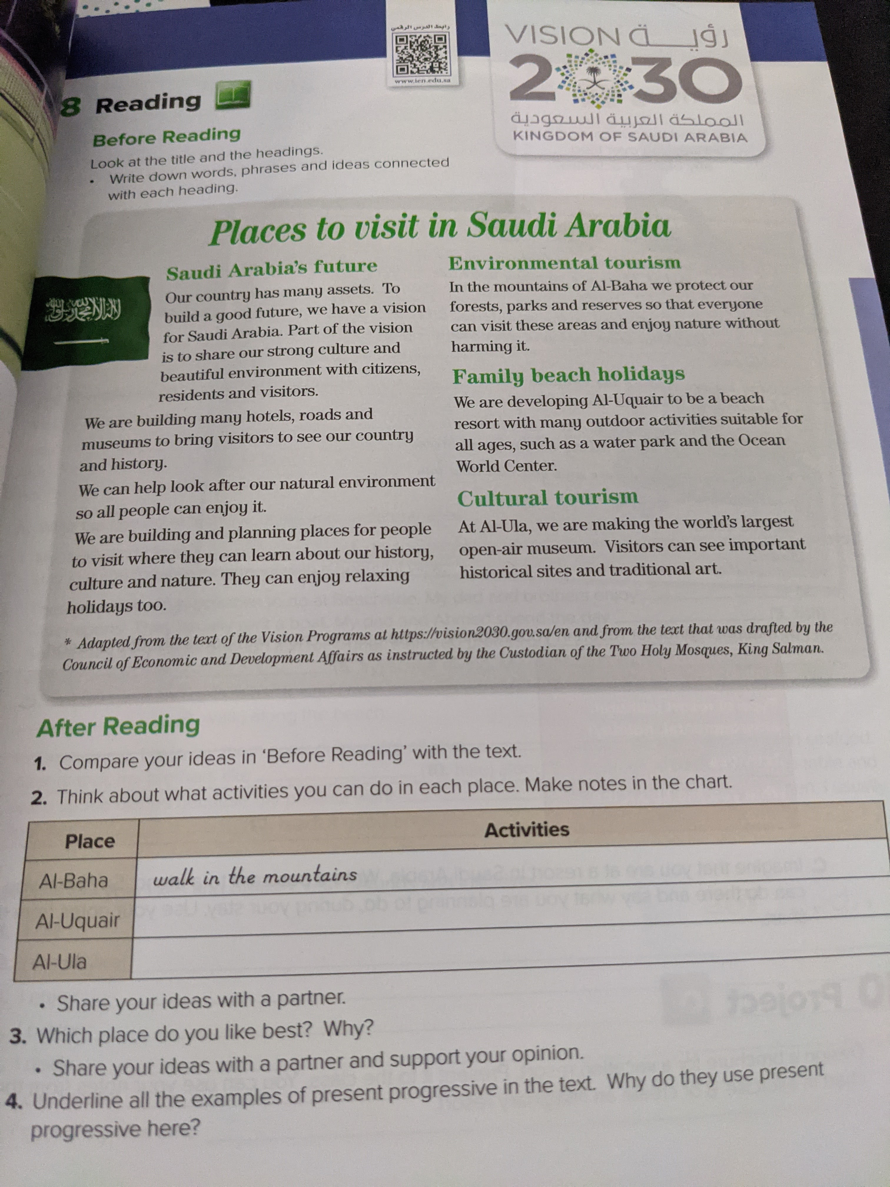
HOMEWORK PAGE31

Slide 9
Thanks for listening

